Slide 1


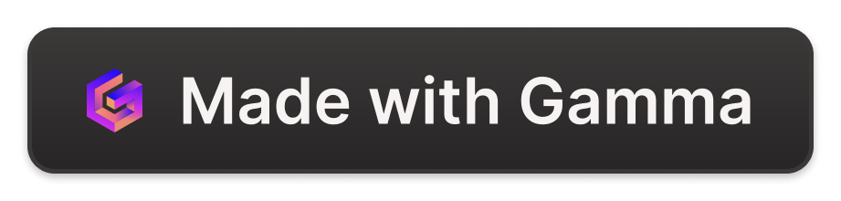
Blockchain Technology in Business Information Systems
Blockchain technology has emerged as a revolutionary innovation in the field of Business Information Technology. This presentation will explore the application of blockchain in enhancing business information systems, focusing on its ability to improve transparency, security, and efficiency in business operations. By decentralizing data storage and implementing cryptographic security measures, blockchain offers a reliable solution to many issues plaguing traditional business information systems.

Slide 2
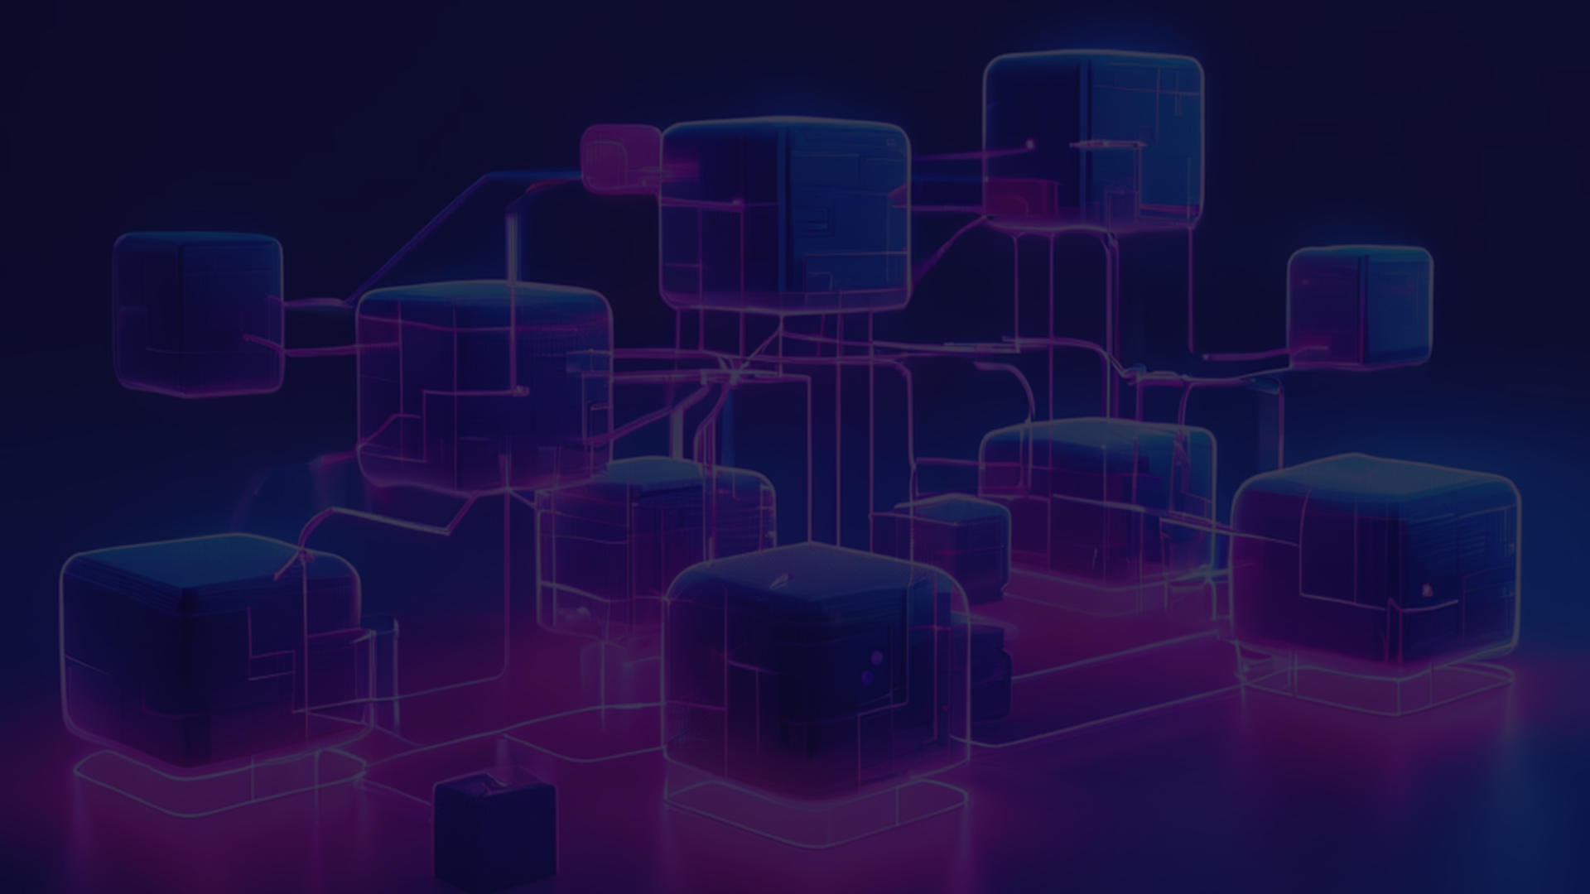
What is Blockchain?
1
Decentralized Ledger
2
Cryptographic Blocks
3
Distributed Network
Blockchain is a decentralized digital ledger that records transactions across many computers in a secure and transparent manner.
The blockchain consists of blocks, each containing a list of transactions. These blocks are linked together in a chain, with each block containing a cryptographic hash of the previous block, a timestamp, and transaction data.
Nodes, or individual computers, participate in the blockchain network, validating and relaying transactions without a central authority.

Slide 3
Key Features of Blockchain
Decentralization
Transparency
Security
Blockchain operates on a peer-to-peer network, with no central authority controlling the data.
All transactions are recorded on a public ledger, allowing anyone to verify them.
Blockchain uses cryptographic techniques to secure data and transactions, preventing unauthorized access and tampering.

Slide 4
How Blockchain Enhances Business Information Systems
1
Improved Data Integrity
2
Enhanced Security
Data stored on the blockchain is consistent and tamper-proof, ensuring the reliability of business information.
Cryptographic security measures prevent unauthorized access and tampering, protecting sensitive business data.
3
Increased Transparency
4
Reduced Operational Costs
The public ledger allows all participants in the network to view transactions, promoting trust in business operations.
Blockchain eliminates the need for intermediaries and streamlines business processes, leading to cost savings.

Slide 5
Real-World Applications of Blockchain
Supply Chain Management
Financial Services
Healthcare
Blockchain facilitates faster and cheaper cross-border payments, enhances security, and automates processes through smart contracts.
Blockchain enables secure sharing of patient data, prevents fraud in medical billing, and ensures the integrity of electronic health records.
Blockchain is used to track the origin and journey of goods, improving transparency and traceability in supply chains.

Slide 6

Case Study: Blockchain in Supply Chain Management
Tracing Food Origins
Increasing Efficiency
Walmart uses blockchain to track the origin of its produce, enabling real-time traceability from farms to stores.
The blockchain-based system improves supply chain efficiency by providing transparency and reducing the time required to trace products.
1
2
3
Improving Food Safety
By quickly identifying contamination sources, blockchain enhances food safety and reduces the time needed for product recalls.

Slide 7

Blockchain in Financial Services
Cross-Border Payments
Enhanced Security
Blockchain-based payment protocols, like Ripple, enable fast, low-cost international transactions, reducing the time and fees associated with traditional banking.
Blockchain's immutable ledger and decentralized network reduce the risk of fraud and cyber-attacks, improving the security of financial services.
Smart Contracts
Self-executing smart contracts automate processes and reduce the need for intermediaries, further lowering costs and increasing efficiency in the financial sector.

Slide 8



Blockchain in Healthcare
Secure Data Sharing
Fraud Prevention
Electronic Health Records
Blockchain enables secure sharing of patient data among healthcare providers while maintaining patient privacy and data integrity.
Blockchain provides a transparent and immutable record of medical transactions, helping to prevent fraud in billing and insurance claims.
Blockchain-based systems, like Medicalchain, allow patients to control their data and grant access to healthcare providers as needed.

Slide 9




Blockchain in Government
Secure Voting
Tamper-Proof Records
Land Registry
Blockchain-based voting systems, like Voatz, enable secure and transparent elections by recording votes on an immutable ledger.
The Republic of Georgia has implemented a blockchain-based land registry system to secure property ownership records.
Blockchain ensures that public records are accurate and tamper-proof, reducing fraud and improving trust in government services.

Slide 10

Future Prospects of Blockchain
1
Integrating with AI and IoT
2
Transforming Global Business
The combination of blockchain with Artificial Intelligence and the Internet of Things can enhance data analysis, decision-making, and real-time automation.
Blockchain is expected to have a significant impact on global business practices, leading to more efficient supply chains, secure financial systems, and improved data management across various industries.
3
Overcoming Challenges
While facing technical, regulatory, and adoption challenges, the potential of blockchain technology to revolutionize business information systems remains immense, and continued development and innovation will be crucial.

